Slide 1
INTRODUCING 365 Permission Manager
READY to Elevate your compliance for Microsoft 365?

Slide 2
Agenda
Product overview
Why do you need 365 Permission Manager?
365 Permission Manager in a nutshell
Key Features & Customer Benefits:
Explore Sites Overview
Quick Actions to perform bulk actions
Define and assign Compliance Policies
Audit Function
Live Demo
Summary

Slide 3
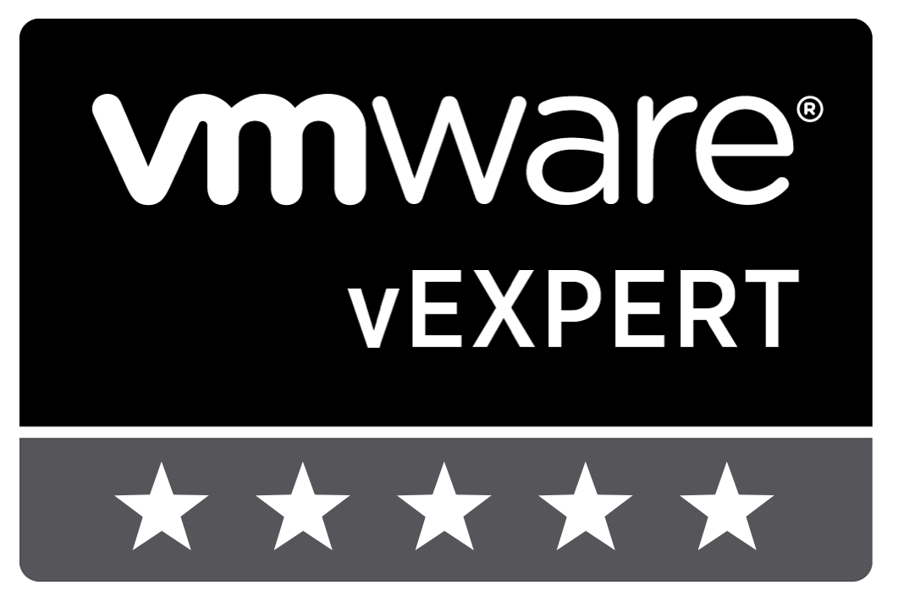
YOUR PRESENTER TODAY
Andy Syrewicze has been in the IT Industry for more than
20 years, is a Microsoft Cloud and Datacenter Management MVP, and currently a Security Evangelist for Hornetsecurity.
Andy Syrewicze
Security Evangelist
Microsoft MVP and VMware vExpert
Mastadon - @andysandwich@infosec.exchange
Notes:
Swap to Matt

Slide 4
YOUR PRESENTER TODAY
Matt Frye has been in the IT Industry for more than
25 years, was a Microsoft evangelist, headed up an MSP for 10 years and currently Head of up Presales, Training and Education at Hornetsecurity.
Matthew Frye
Head of Presales
Head of Training and Education

Slide 5
GLOBAL EXPERT IN EMAIL CLOUD SECURITY, COMPLIANCE AND BACKUP
OUR VALUE PROPOSITION
OUR MISSION
OUR VISION
"We empower companies and organizations of all sizes to focus on their core business by protecting email communications, securing data, and ensuring business continuity and compliance with next-generation cloud-based solutions."
“Hornetsecurity will be the guardian of companies worldwide that use Microsoft 365. We protect their data and ensure business continuity. For a safer 365 world!”
"We offer the most comprehensive cloud security solution for Microsoft 365 on the market, including email security, compliance and backup."
Notes:
Mission Statement: A formal but simple explanation of its purpose.
Vision Statement: A vision statement is an organization's declaration of its mid-term and long-term goals, stating what they want to become in the future.
Value Proposition: A value proposition refers to the value a company promises to deliver to customers should they choose to buy their product.

Slide 6
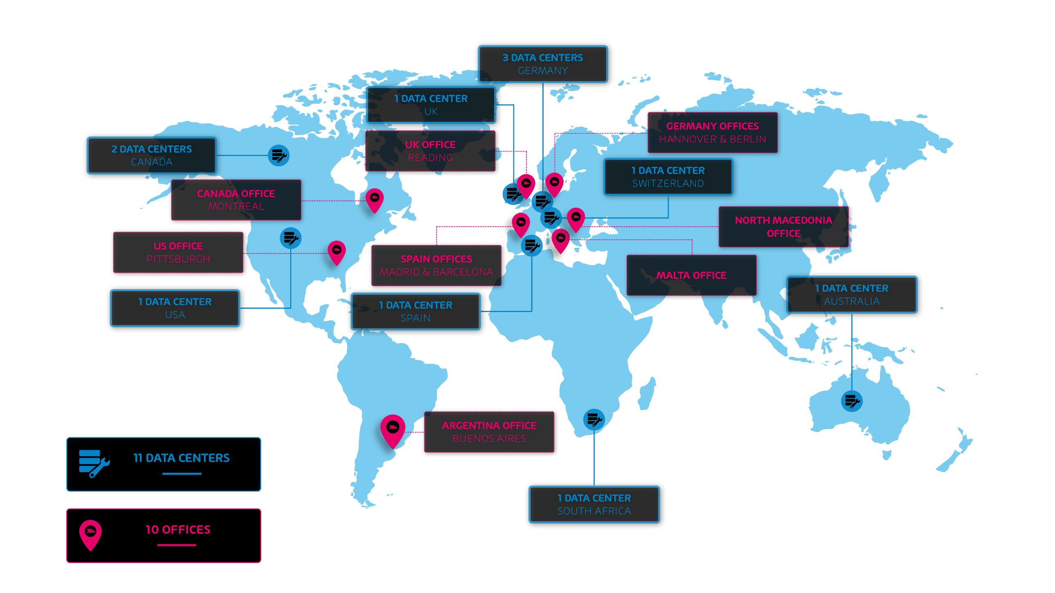
HORNETSECURITY WORLDWIDE

Slide 7
HOW IT ALL STARTED – OUR STORY
Notes:
Our story is a story of growth and success: Founded in Hanover, Germany, in 2007 to develop cloud security services,
the company opened a US subsidiary, Hornetsecurity Inc., in 2017 to enter the North American market.
In June 2018, Hornetsecurity acquired the spam filter division of AVIRA, giving us a foot hold in the Benelux
In January 2019, Hornetsecurity acquired the Spanish email security company Spamina, positioning itself as the leading German cloud security provider for email in Europe. And giving us reach into South America.
With the acquisition of long-time distribution partner EveryCloud in January 2020, Hornetsecurity strengthened this position and significantly increased its presence in the English-speaking market. We further expanded our market presence in North America with its March 2021 acquisition of the Canadian email security provider Zerospam.
In January 2021, Hornetsecurity acquired Altaro, the leading backup and recovery specialist with a global customer base. This strategic development enabled Hornetsecurity to add robust backup and replication solutions to its product portfolio, with a particular focus on Microsoft 365.
In May 2022, Hornetsecurity acquired IT Seal, a security awareness training company.
Each of Hornetsecurity’s strategic acquisitions serve to enhance and extend the company’s position as a leading provider of security, data loss prevention and compliance solutions, with a particular focus on the Microsoft 365 environment.

Slide 8
GROWTH FIGURES EMPLOYEES
2022:
400
2021:
335
2020:
183
2019:
130
2018:
120
2017:
95
Notes:
Of course, this strategic development in our solution offering is supported by organizational growth: having started as a pioneer in cyber security solutions for email, we now cover backup and security awareness training. Plus we also developed to a popular employer having a 321,05% increase of employees from 2017 to 2022.

Slide 9
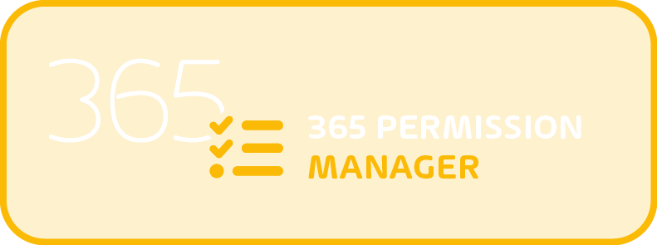
Product overview
Elevate your compliance for Microsoft 365
UNDERSTAND WHAT IS SHARED AND HOW
CONFIGURE & MONITOR SHARING POLICES
IDENTIFY VIOLATIONS & DELEGATE AUDITS

Slide 10
Why do you need 365 Permission Manager?
Microsoft 365 provides a range of tools that can help your business work more efficiently, such as real-time collaboration on documents, the ability to access and work on documents from any device, and integration with other business tools and services.
But for CISOs & M365 administrators, it is a nightmare keeping track of who needs access to what and preventing Critical Data Leakage situations.

Slide 11
Challenges in Microsoft 365
Management of M365 Infrastructure
Data Access
Governance
Rapid growth of SharePoint, Teams, OneDrive and M365 Groups
Jumping back and forth from one M365 portal to the next
Complicated Permissions structure
Risky Default configurations
No easy way to identify external sharing exposure
Lack of Access Overview, only File by File
Limited bulk permissions management options
Complicated monitoring tools
Lack of Reporting
All or Nothing approach to restrictions
Orphaned permissions & resources left behind

Slide 12
Why do you need 365 Permission Manager?
Access only ever increases and never gets reduced!
No user goes into Teams and says, “We no longer work with this freelancer, let’s remove his access!”
Audits are never done by the people who understand the data and access granted to it!
No CISO knows which external user needs access to what, and with hundreds of shares happening every day, traditional audits become outdated within a matter of hours!
M365 has an All or Nothing approach to controlling sharing with no wiggle room for the Real World
With Admins forced to leave control up to the users to do what’s best, it’s only a matter of time until critical data gets leaked!

Slide 13
Why do you need 365 Permission Manager?
Real-life cases that can lead to critical compliance States in Microsoft 365:
Inherited group access
A new employee is added to an existing group. This gives them access to all sites, folders and files for that the group has access to which can have confidential information.
Stay Secure & Compliant
With 365 Permission Manager, you are alerted as soon as new users get access to this confidential information.

Slide 14
Why do you need 365 Permission Manager?
Real-life cases that can lead to critical compliance States in Microsoft 365:
Default Site Configuration in M365
Some default settings in M365 can be disastrous: for example, the default behavior in Teams is to create anonymous publicly accessible links whenever someone shares a file over chat.
Stay Secure & Compliant
With 365 Permission Manager you can apply best practice configurations to different groups allowing you to monitor, alert, and remediate these settings instantly.

Slide 15
Why do you need 365 Permission Manager?
Real-life cases that can lead to critical compliance States in Microsoft 365:
Employee leaves the company
An employee with access to confidential information leaves the company. Even though the user's password is reset by IT, the employee’s access is still active for some time after.
Stay Secure & Compliant
With 365 Permission Manager, you can instantly identify which sites, folders and files the user has access to and revoke the user's permissions IMMEDIATELY.

Slide 16
Why do you need 365 Permission Manager?
Real-life cases that can lead to critical compliance States in Microsoft 365:
Allow collaboration with control
In M365 you can only decide if you want to allow collaboration with external users or block it entirely. Both options do not work in the real world.
Stay Secure & Compliant
With 365 Permission Manager, you can monitor for external sharing and automatically alert and request approval of these shares by the right people.

Slide 17
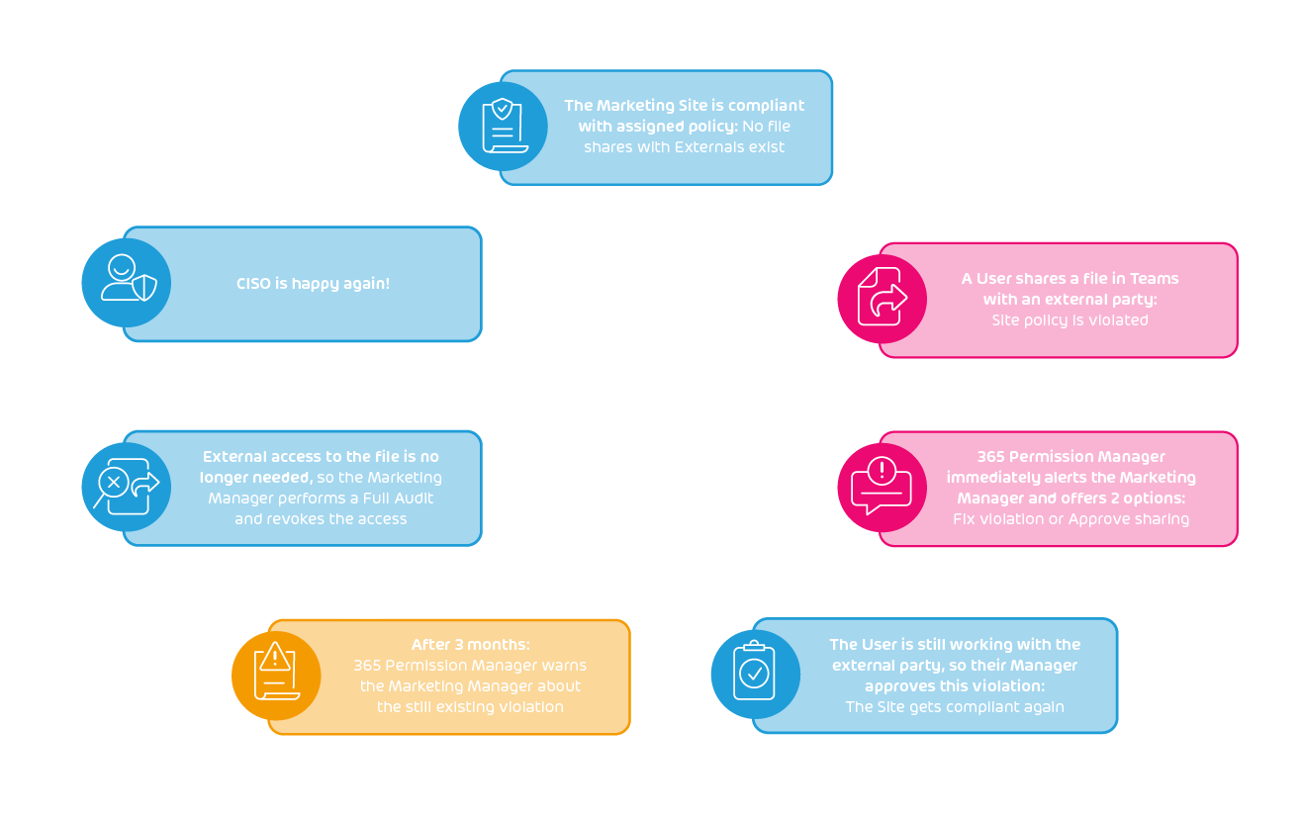
365 Permission Manager - Audit Lifecycle
From Sharing to Audited

Slide 18
LIVE DEMO – PERMISSION MANAGER
Notes:
Remove “Everyone” Permissions
Set External Sharing Level
Clean Up Orphaned Users
Revoke Access for a User or Group
Set Site Permissions
View permissions as a particular user or group
Detailed access overview of user, group and nested group permissions
Single click report generation
Non-obstructive workflow to easy audit and revert permissions
M365 Tenant Onboarding Wizard
Attractive conditions for customers and partners

Slide 19
Summary
365 Permission Manager suits you with the following advantages:
EASE OF USE: Offers you a convenient way to get a comprehensive view of permissions in SharePoint, Teams and OneDrive.
TIMESAVING: Saves you time and effort by enabling you to perform bulk actions to manage permissions.
GOVERN COMPLIANCE: Enables you to set and enforce compliance policies for sharing sites, files, and folders.
COMPLIANCE MONITORING: Allows you to easily monitor the states of policy compliance and to audit policy violations.

Slide 20
WE PROTECT YOU

Slide 21
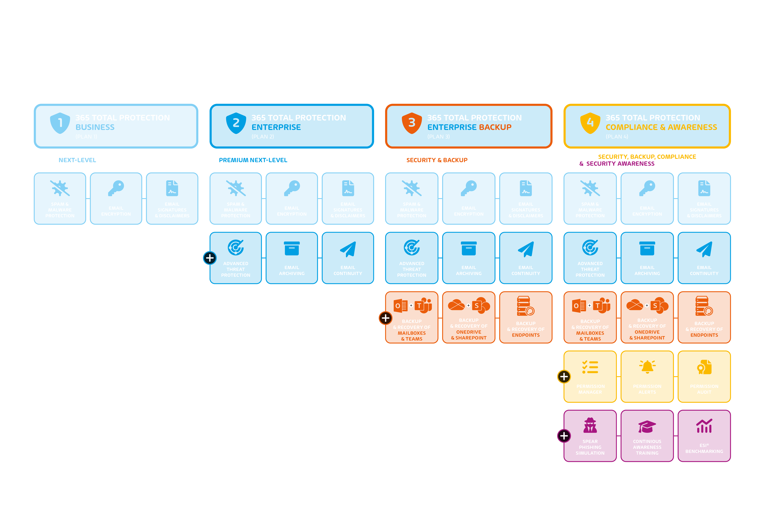
COMING SOON
Notes:
365 Total Protection ist die umfassendste Sicherheitslösung für Microsoft 365 auf dem Markt, die E-Mail-Kommunikation und Daten schützt und Compliance und Sicherheitsbewusstsein fördert. 365 Total Protection ist in 3 und bald in 4 Paketen erhältlich und bietet Flexibilität, damit Sie die Lösungen auswählen können, die Sie am meisten benötigen.

Slide 22
How Would You Like Us to Follow Up?
1
2
3
Sign me up for your newsletters!
I‘d Like a Free Trial of 365 Permission Manager!
Schedule an individual appointment with one of our experts
*Type your selection in the Q & A Box!

Slide 23
ASK A QUESTION!
Do you have questions or input of your own?
U HAZ QUESTION?

Slide 24
Notes:
Deepl l transalation – had to keep it in LOL
Horny, hot shit
Huge market, huge demand
Now it's about getting the word out to the people.
Hope you are also looking forward to it
Questions?

